Slide 1

My Linear Relationships Interactive Notebook
Name
Class
Term 4 Semester 2

Slide 2
Contents
Formula Page
Page
Date
Description
2
3

Slide 3
Tasks
24
7
30
Essential Question
Questions
Notes
Summary

Slide 4
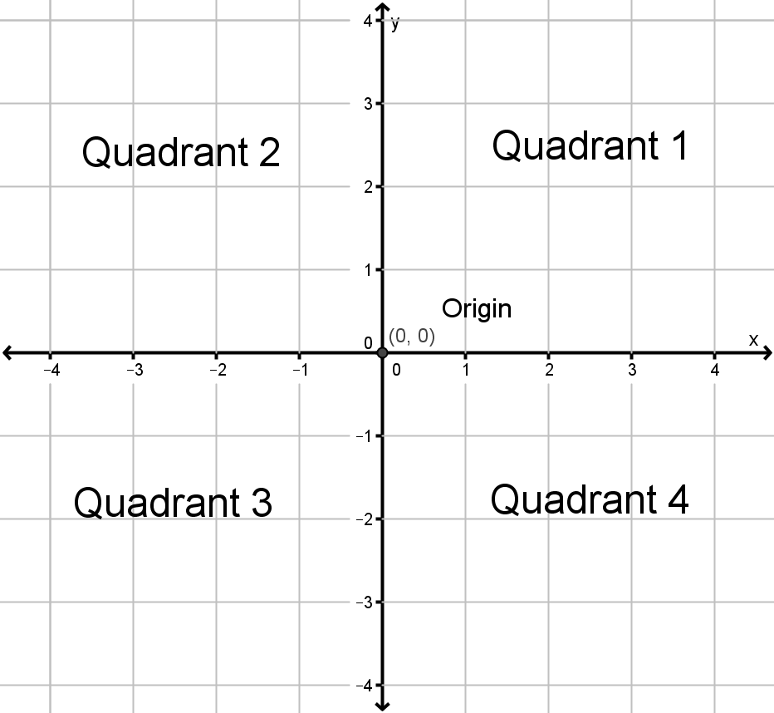
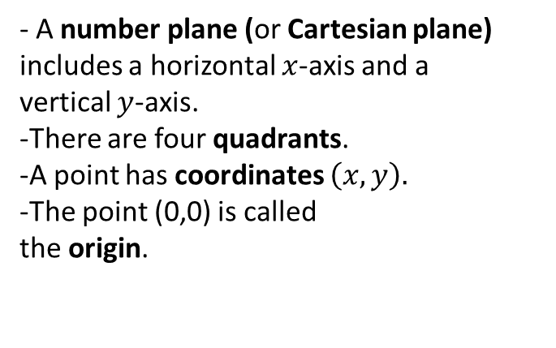
24
7
30
Date
Coordinates
EQ – What is a Cartesian plane?
- A number plane (or Cartesian plane) includes a horizontal $x$-axis and a vertical $y$-axis.
-There are four quadrants.
-A point has coordinates $\left(x,y\right).$
-The point (0,0) is called
the origin.

Slide 5
Questions

Slide 6
Notes Review
24, 7 ,30
Date
Title
Essential question
Notes complete
Notes complete with colour and diagrams
Questions completed
Contents page filed in
Formula page filled in

Slide 7
Homework
Review your notes and write a summary answering the essential question.

